Slide 1

VOTER REGISTRATION AND IDENTIFICATION
Clayton Boyd Walden, Director Division of Motorist Services

Slide 2
Voter Registration Processing
Since 1995, any office that issues driver licenses or state identification cards are legally required to provide voter registration services at the same time.
It is a part of every examiner’s responsibility to ask all eligible customers if they are interested in applying for voter registration or changing information on their current voter registration record.
Customers being processed for a driver license or identification card must meet all eligibility requirements to apply for voter registration.

Slide 3

Eligibility Requirements
The applicant must be:
US Citizen
Florida Resident
At least 16 years of age
If ever a felon - rights must be restore
If ever adjudged incompetent – competency must be restored

Slide 4
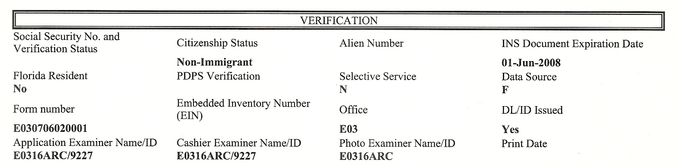
Application Requirements
To apply for voter registration, both Citizenship Status should indicate US Citizen and Florida resident should indicate Yes. If it does not, Voter registration application is not available.

Slide 5
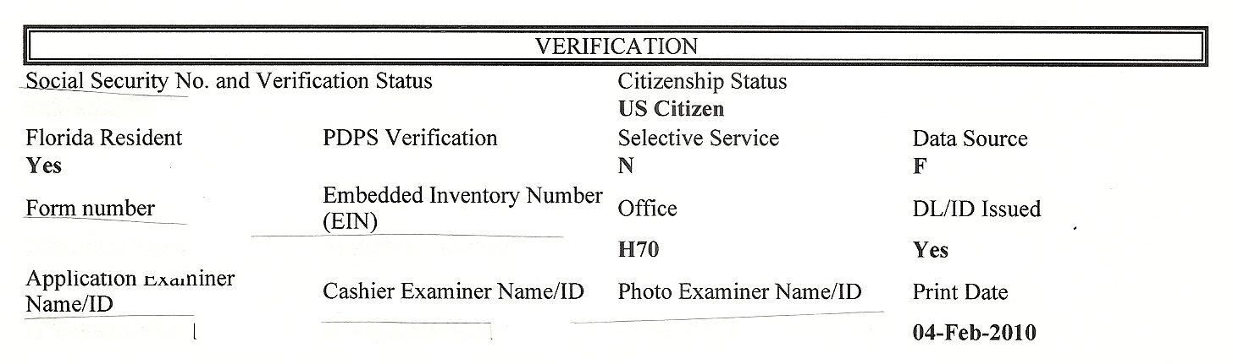
Application Requirements
To apply for voter registration, Citizenship Status should indicate US Citizen and Florida resident should indicate Yes.

Slide 6

Application Types
New = a customer who is not currently registered in Florida and is applying for voter registration.
Reissue = an application for duplicate of customer’s current voter registration card.
Change = an application for change of name, date of birth, address or party affiliation.

Slide 7
Application Types
Current = customer currently registered to vote and all the information on their voter registration card is correct.
Declined = an eligible customer declined to apply for voter registration.
Ineligible = customer does not meet eligibility requirements to apply for voter registration.
Signature Update = customer received notification from the Supervisor of Elections that no signature was on the motor voter application.

Slide 8
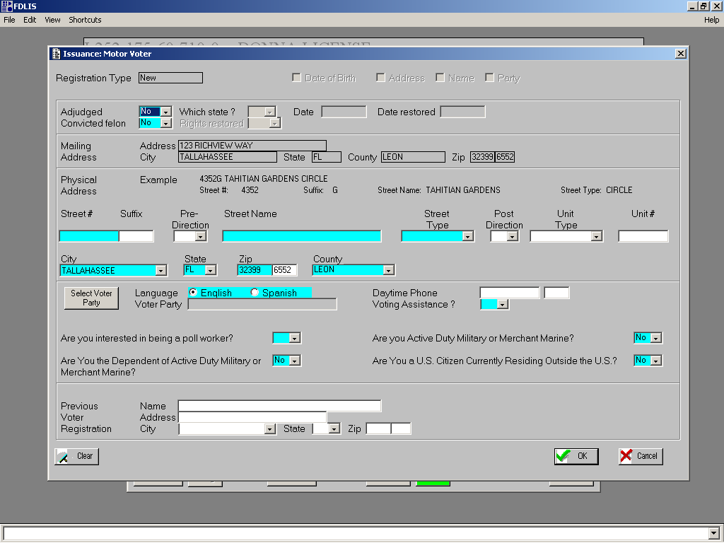
Motor Voter Issuance Screen

Slide 9
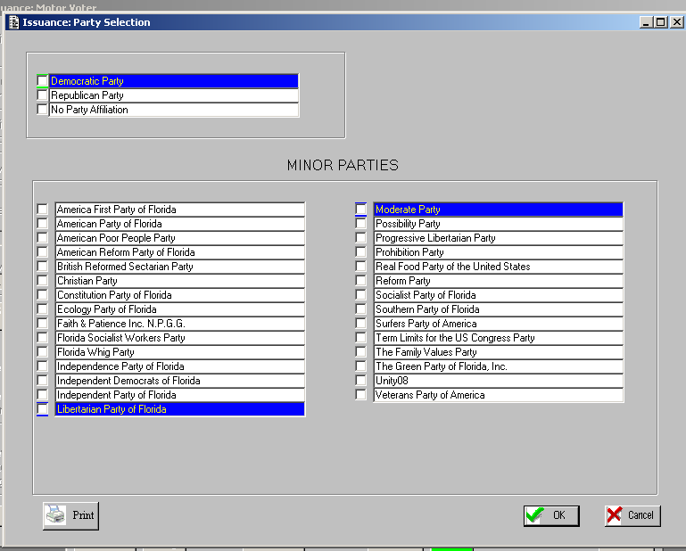
Party Selection Screen
If the customer is unsure of his/her party affiliation, each office has a list of parties they may review to make their selection.

Slide 10
Motor Voter Issuance
Application Verification Sheet – After electronic entry of all Motor Voter information, the examiner will print the intake application for the customer to review. A copy of the application is printed in all cases whether it is a new registration or an update and given to the customer.
Review Information - The customer is instructed to read the oath, and review and verify that the voter registration information entered is correct especially the name, address, and political party selection.
Upon completion of the review, the voter registration application is processed.

Slide 11
Legal Presence and Address Verification
DRIVER & VEHICLE EXPRESS
(DAVE)

Slide 12
DAVE: Driver And Vehicle Express
Access to DAVE is available to certain government agencies once the Department of Highway Safety and Motor Vehicles (Provider Agency) and the Requesting Agency enter into a Memorandum of Understanding (MOU) which establishes the purposes for and conditions of electronic access to DAVE.
The Requesting Agency will identify a Point of Contact (POC) who will coordinate with HSMV.
PLEASE NOTE: DHSMV IS CURRENTLY IDENTIFYING A FEE STRUCTURE FOR DAVE ACCESS. FEES WOULD BE IMPLEMENTED FOR THE SOLE PURPOSE OF MAINTAINING THE DAVE SYSTEM. ONCE THE FEE STRUCTURE IS IN PLACE, ALL USERS WILL BE NOTIFIED IN WRITING.

Slide 13
Confidential personal information is defined by the laws listed below.
Driver Privacy Protection Act (DPPA) – Federal law
Section 119.071 (4), Florida Statutes
The Providing Agency is responsible for protecting information defined as confidential or as otherwise prohibited from public inspection or copying under Public Records Law.
The Requesting Agency is responsible for protecting confidential information by ensuring users with access are instructed on confidential nature of information.
The Requesting Agency is responsible for ensuring users acknowledge their understanding of confidentiality requirements.
Confidentiality

Slide 14
Confidentiality
Confidential information includes:
Name
Address
Social Security Number
Telephone Number
Driver Identification Number
Medical, Disability or Emergency Contact Information (ECI)
Photograph or digital image of a public official or motorist

Slide 15
Proper Use of DAVE
  Accessing information for legitimate business purposes for your agency as identified in Memorandum of Understanding and Florida Statute
  Disclosing information only to persons authorized to receive data

Slide 16
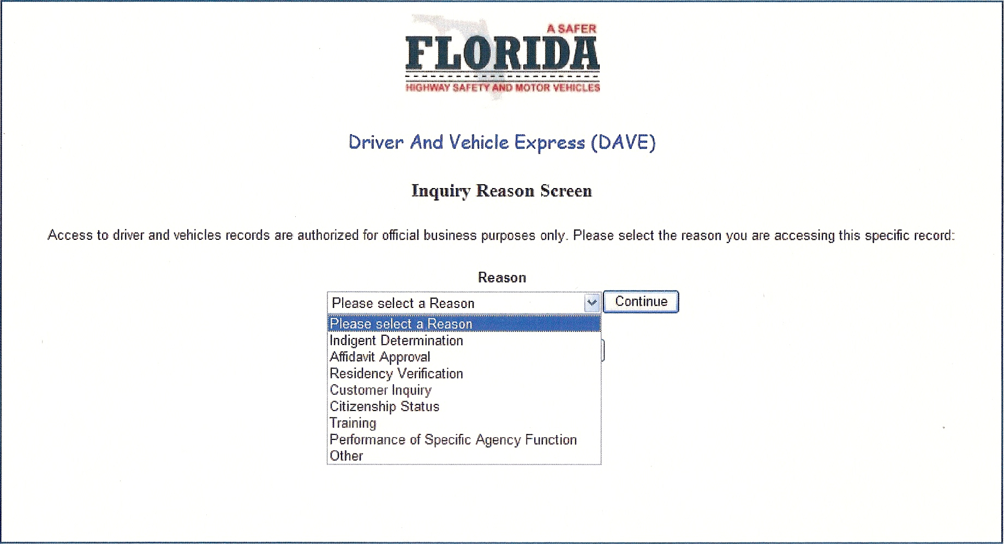
DAVE Inquiry Screen
Users are required to state a reason why they are making inquiries on DAVE. The user must choose an appropriate reason and click on the “Continue” button. This will assist agencies in monitoring individual user activity.

Slide 17
Improper Use of DAVE
Examples:
Checking family member’s driving record.
Looking up celebrities or politicians.
Checking tag numbers of people you see in traffic.
Copying information to supply to friends, family, public.
Looking up addresses for Christmas card mailing list.
Posting information on information boards or blogs where
public may see the information.

Slide 18
Penalties for Misuse
Violation of F.S. 119, Public Records, is a misdemeanor of the first degree.
Violation of Driver Privacy Protection Act (DPPA) subject to criminal sanctions and civil liability.
Immediate termination of user access and/or requesting Agency MOU and DAVE access by Providing Agency.
Internal agency disciplinary actions.

Slide 19
Misuse Compliance
The MOU states, “The Requesting Party must immediately notify the Providing Agency and the affected individual following the determination that personal information has been compromised by any unauthorized access, distribution, use, modification, or disclosure.”
The Requesting Agency will need to submit to the Department of Highway Safety and Motor Vehicles the following information to stay in compliance:
Brief Summary of incident on agency letterhead
Outcome of review
Number of records compromised
Were the owners of the compromised information notified?
If not, when will notification take place?
What disciplinary action (if any) took place due to this misuse?
What policies or procedures has your agency implemented to prevent future DAVE misuse?

Slide 20
Once every three years, the Providing Agency will request in writing, the submission of an attestation indicating that: a. an audit of internal controls was performed b. the audit indicates the controls are adequate to protect confidential personal data c. the attestation was completed by a CPA, internal auditor or inspector general
The attestation must be received by the Providing Agency within 180 days of written request
MOU Auditing Requirements
Requesting Agency must provide:
Ongoing monitoring
Quarterly quality control reviews to ensure all current users are appropriately authorized
An annual affirmation verifying MOU compliance

Slide 21
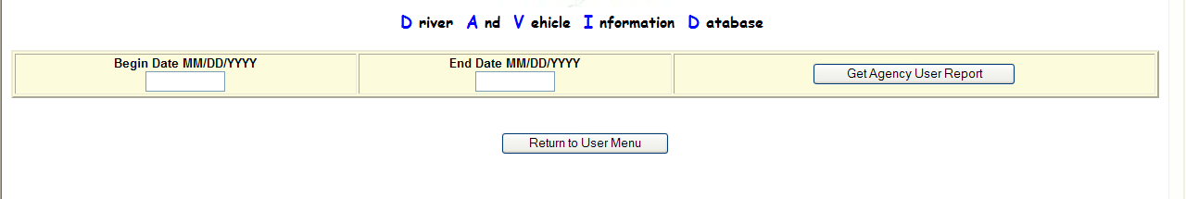
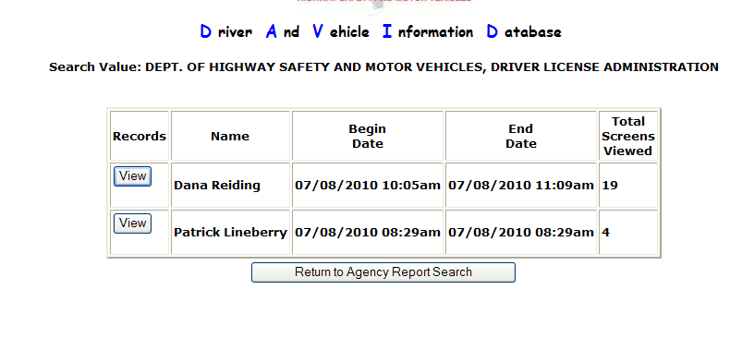
Audit Tool
Driver And Vehicle Express
Driver And Vehicle Express

Slide 22
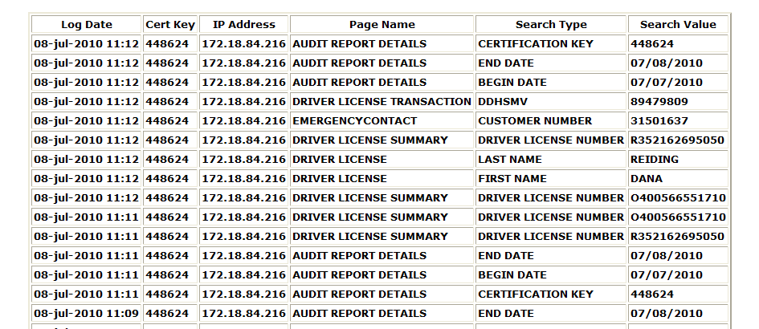
Audit Tool
Driver And Vehicle Express

Slide 23
Contact Information
For questions concerning DAVE, please contact your agency’s DAVE Administrator.
If you are unaware of your agency’s DAVE Administrator, contact Davidsupport@flhsmv.gov

Slide 24
QUESTIONS?

